Slide 1

TASK SCHEDULING
FOR MULTI-CORE ASYMMETRIC SYSTEMS
Pablo Ruiz

Slide 2

Why it Matters?
As processors become larger and more powerful, they reach a power limit at which cooling and maintaining performance starts becoming impractical.
Mobile devices were the first to run into this problem due to their form factor, limited cooling and reliance on batteries.
In order to extract the most efficiency per watt multi-core, asymmetric designs are becoming the norm.
Schedulers must change in order to use different cores for different purposes as efficiently as possible.

Slide 3
Discussed and Proposed Scheduling Strategies
Discussed:
Criticality-Aware Scheduler (CATS)
Proposed:
Critical Path Scheduler (CPATH)
Hybrid Criticality Scheduler (HYBRID)
Dynamic implementation of Heterogeneous Earliest Finish Time (dHEFT)

Slide 4
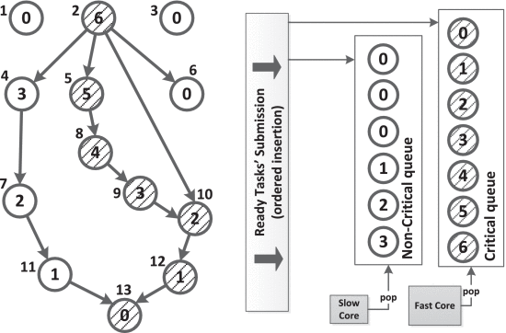
What is a Task Dependency Graph (TDG)?
Displays the dependency chain for the task within an application.
Each node represents a task.
Each edge represents a dependency between the tasks.
The filled (dashed) nodes are considered critical.
The number outside each node represents its ID.
The number within each node is the bottom level, or the number of “hops” between itself and a leaf node (node which does not have a child/dependent).
Bottom level indicates task priority.
Slow cores process non-critical tasks and fast cores process critical tasks.
Figure [1]: CATS Example. Task Dependency Graph.

Slide 5
Criticality-Aware Scheduler (CATS) Critical vs. Non-Critical Tasks
Critical tasks are those that belong to the longest path of the TDG.
At runtime, the longest path changes as tasks are completed.
Once a task’s dependencies are completed it is ready to join a queue.
The criticality of a task is determined by two conditions:
Is it of higher or equal priority to the previous critical task?
Is it the highest priority child of the previous critical task?
The first critical task is that with the highest priority which is equal to or greater than one.
Figure [1]: CATS Example. Task Dependency Graph.

Slide 6
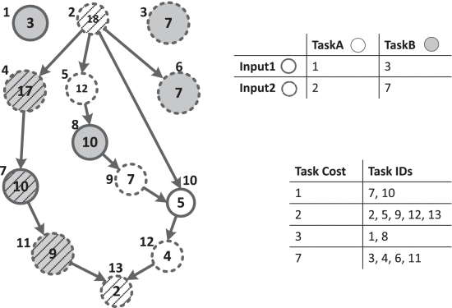
Critical Path Scheduler (CPATH): Accounting for Task Execution Time
The criticality of a task path is determined by its estimated execution time rather than just its length.
The execution time cost is referred to as the bottom cost.
The execution time of a node is based on its task type and its input size.
This method assumes that if these attributes are comparable the execution time will be comparable.
Recomputes priority levels after each critical task computation.
This method increases the scheduling overhead costs due to it dynamically calculating the priority levels.
Figure [2]: CPATH Example. Task Dependency Graph w/ tt-is graph.

Slide 7
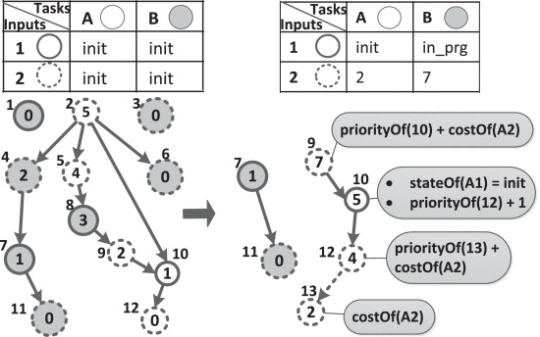
Hybrid Critical Scheduler (HYBRID): CATS with some CPATH
Combination of CATS and CPATH.
Uses mainly CATS and includes the execution time only when available to reduce overhead.
In CATS the priority levels are computed before hand when tasks are created.
In CPATH after every critical task is completed the performance core has to be devoted to priority calculations before it can begin processing the next critical task.
HYBRID attempts to calculate bottom cost like CPATH but it does it at task creation like CATS.
This reduces the overhead but is not as accurate as CPATH in selecting the true critical path because it may lack information on the time cost of task type-input size combinations.
If time completion information is not available, it defaults to CATS and assigns that task a cost of one.
Figure [3]: HYBRID Example. On the right figure notice how only the path that had an element added to it is recalculated.

Slide 8
Dynamic Heterogeneous Earliest Finish Time Scheduler (dHEFT): Which core is better for each type of task?
Traditional HEFT strategies use the task computation and communication costs to calculate the priority of a task within a path.
Additionally, it then chooses the processor core/type that will meet those costs in the shortest amount of time.
HEFT assumes known task execution and communication times at compile time and thus all scheduling is done before tasks start executing.
Since in real applications execution and communication times are not known at compile time dHEFT was developed.

Slide 9
Dynamic Heterogeneous Earliest Finish Time Scheduler (dHEFT): Which core is better for each type of task?
dHEFT keeps a tt-is table and a task-core cost table.
These tables are updated at runtime as tasks execute.
If no data is present for a given task/core combination then a task will be sent to the first available core of that type to collect data until at least three data points are collected.
Its task prioritization strategy is very similar to CPATH and uses a tt-is table analogue.

Slide 10
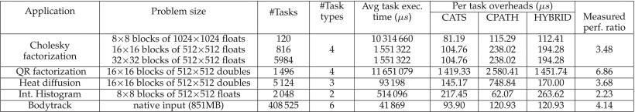
Results
Table [1]. Presents the per task data gathered for each application using each of the proposed schedulers.
Includes the avg. task execution time and overhead per task for each of the proposed schedulers and each application.
Additionally, the perf. Ratio represents the performance ratio between big and little cores respectively.

Slide 11
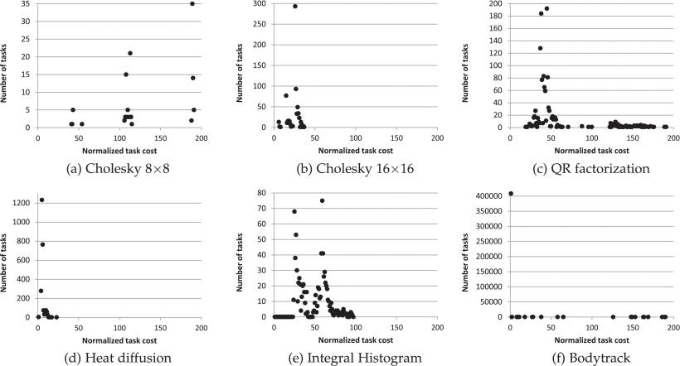
Results
Figure [4]: Graphs representing the number of tasks and their cost for each application.

Slide 12
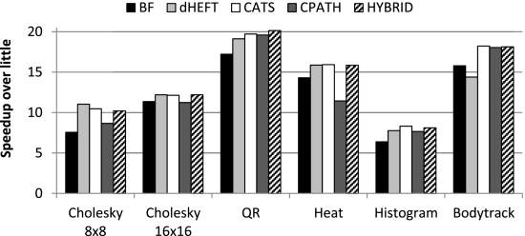
Results
Figure [5]: Completion speed of each application for each scheduler compared to completing the whole application using a single little core.
**Results obtained using an 8-core Odroid-XU3

Slide 13
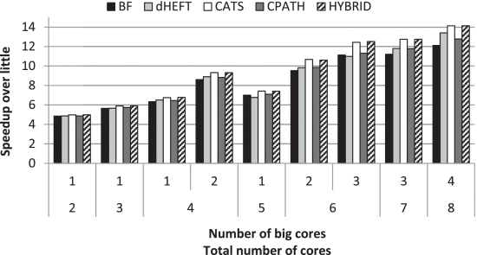
Results
Figure [6]: Average of the performance across all applications with different core configurations.

Slide 14
Conclusion:
All of the discussed scheduling strategies improve on the performance of a traditional homogenous scheduler as the number of cores in a heterogenous processor increases.
When the heterogeneity is low and a large percentage of the system cores are homogenous, scheduling strategies with high overhead like dHeft can fall behind traditional homogenous schedulers.
All the scheduling approaches shown in this presentation obtain the information they need to schedule tasks at runtime, making them more suited to use in real systems.
These results make it clear that more complex scheduling approaches are not always beneficial due to their increased overhead, specially when an application a small number of tasks.

Slide 15
References:
Chronaki, K., Rico, A., Casas, M., Moreto, M., Badia, R. M., Ayguade, E., Labarta, J., & Valero, M. (2017). Task scheduling techniques for asymmetric multi-core systems. IEEE Transactions on Parallel and Distributed Systems, 28(7), 2074–2087. https://doi.org/10.1109/tpds.2016.2633347

